Slide 1
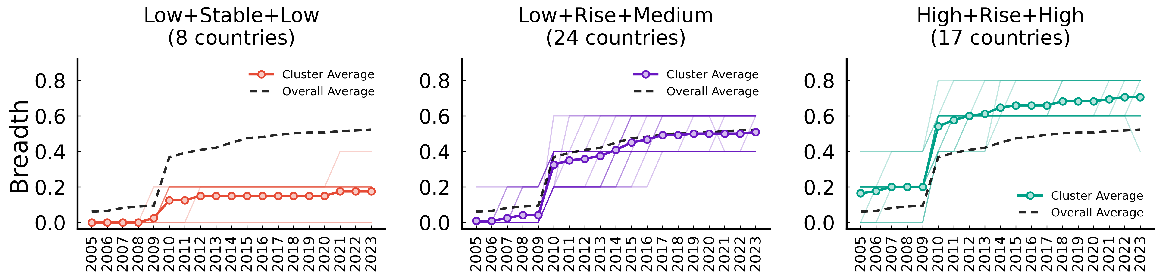
Buildings – market-based instruments (Breadth)
ID | Trajectory Features | Mean Start | Countries
Cluster 0 | Low -> Stable -> Low | 0.000 | 8 (ARG, CRI, HRV, MLT, PER, ROU, RUS, SAU)
Cluster 2 | Low -> Rise -> Medium | 0.014 | 24 (AUS, BGR, CHE, CHL, CHN, COL, CZE, EST, GRC, ID...)
Cluster 1 | High -> Rise -> High | 0.180 | 17 (AUT, BEL, CAN, DEU, DNK, ESP, FIN, FRA, GBR, HU...)

Slide 2
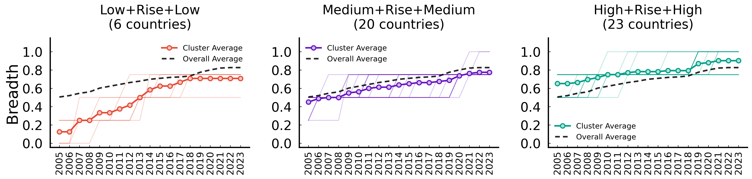
Buildings – non market-based instruments (Breadth)
ID | Trajectory Features | Mean Start | Countries
Cluster 1 | Low -> Rise -> Low | 0.167 | 6 (CHL, COL, ISL, PER, SAU, ZAF)
Cluster 2 | Medium -> Rise -> Medium | 0.479 | 20 (ARG, AUS, CAN, CHE, CRI, CZE, ESP, EST, HRV, ID...)
Cluster 0 | High -> Rise -> High | 0.656 | 23 (AUT, BEL, BGR, CHN, DEU, DNK, FIN, FRA, GBR, GR...)

Slide 3
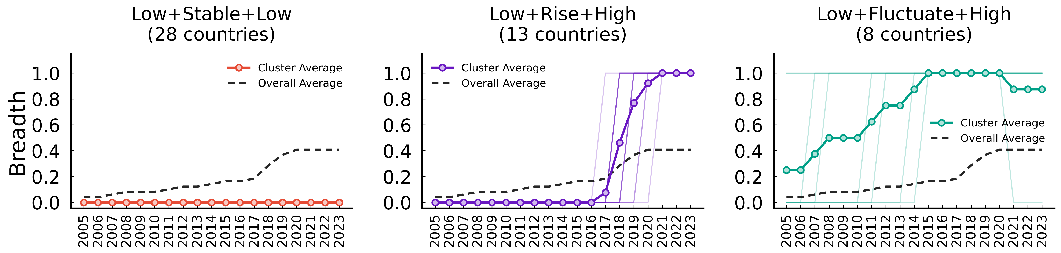
Climate governance (Breadth)
ID | Trajectory Features | Mean Start | Countries
Cluster 0 | Low -> Stable -> Low | 0.000 | 28 (ARG, AUT, BEL, BGR, CZE, ESP, EST, HRV, HUN, ID...)
Cluster 1 | Low -> Rise -> High | 0.000 | 13 (CAN, CHL, COL, CRI, DEU, FRA, GRC, ISL, KOR, ME...)
Cluster 2 | Low -> Fluctuate -> High | 0.292 | 8 (AUS, CHE, CHN, DNK, FIN, GBR, IRL, LTU)

Slide 4
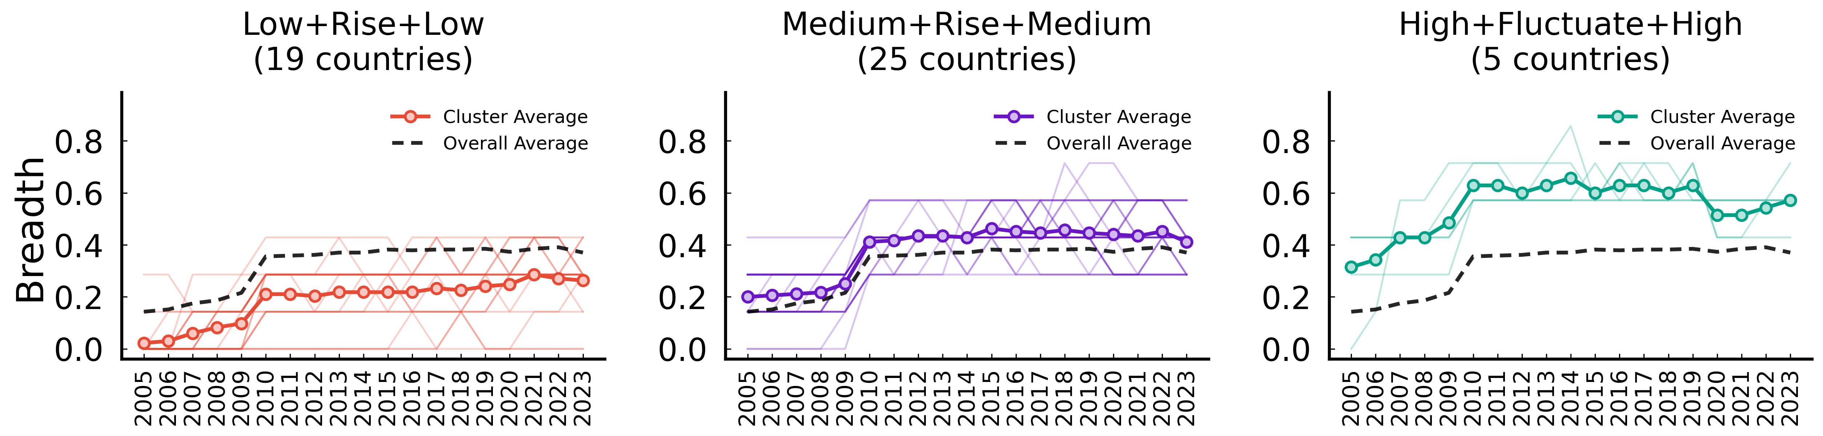
Electricity – market-based instruments (Breadth)
ID | Trajectory Features | Mean Start | Countries
Cluster 0 | Low -> Rise -> Low | 0.038 | 19 (ARG, BGR, COL, CRI, HRV, HUN, IDN, ISL, ISR, LT...)
Cluster 2 | Medium -> Rise -> Medium | 0.206 | 25 (AUS, AUT, BEL, CHE, CHL, CHN, CZE, DEU, DNK, ES...)
Cluster 1 | High -> Fluctuate -> High | 0.362 | 5 (CAN, EST, GBR, ITA, SWE)

Slide 5
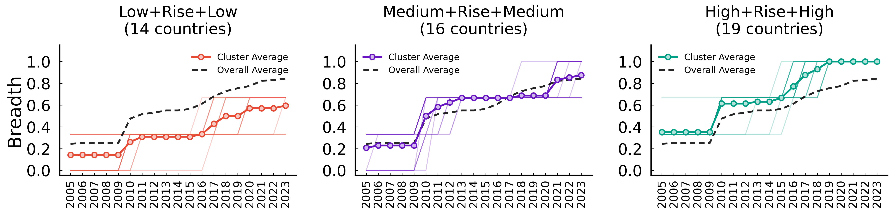
Electricity – non market-based instruments (Breadth)
ID | Trajectory Features | Mean Start | Countries
Cluster 0 | Low -> Rise -> Low | 0.143 | 14 (ARG, CHN, COL, CRI, EST, ISL, ISR, LTU, LVA, ML...)
Cluster 2 | Medium -> Rise -> Medium | 0.222 | 16 (AUS, BGR, CHL, CZE, HRV, IDN, IND, JPN, KOR, LU...)
Cluster 1 | High -> Rise -> High | 0.351 | 19 (AUT, BEL, CAN, CHE, DEU, DNK, ESP, FIN, FRA, GB...)

Slide 6
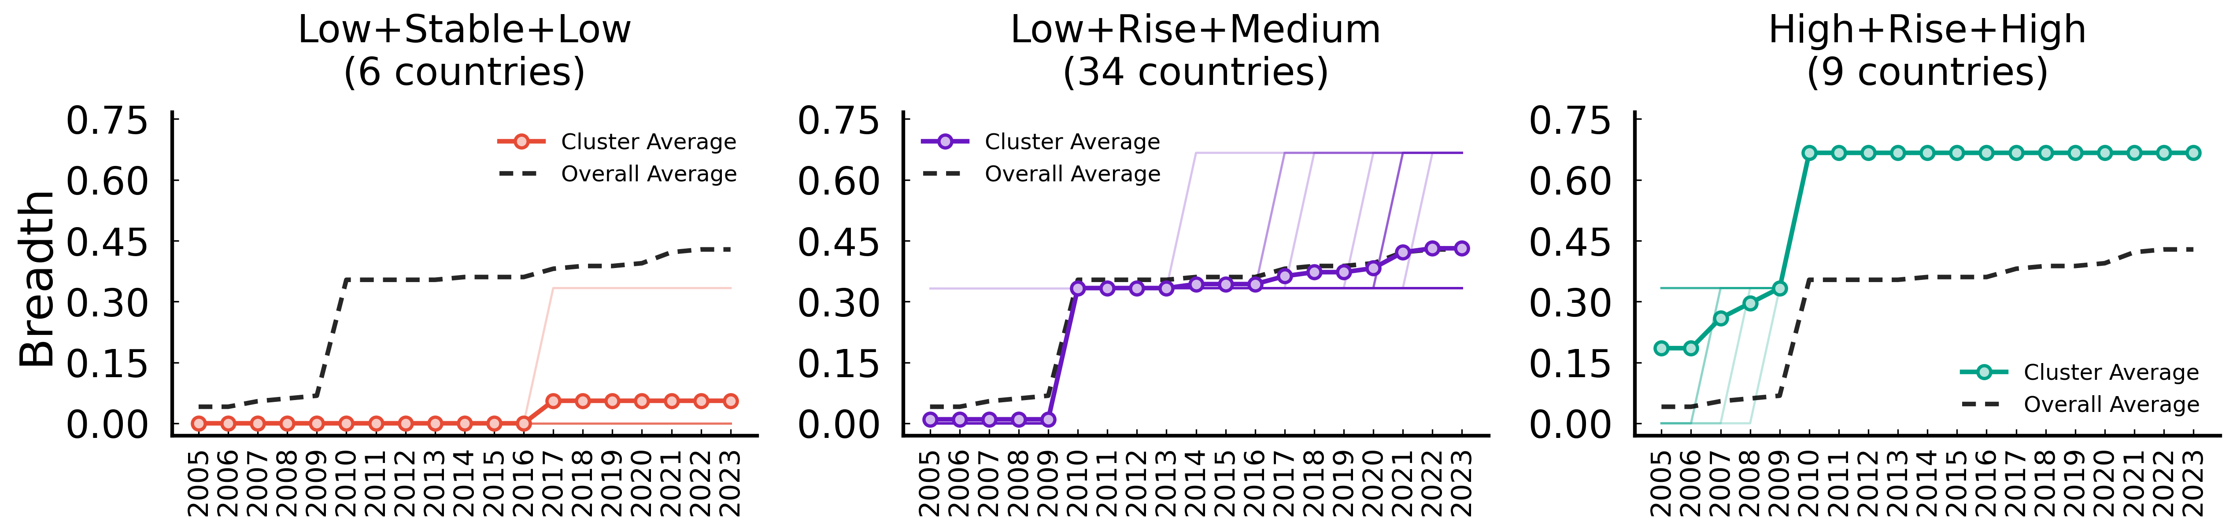
Fossil fuel production policies (Breadth)
ID | Trajectory Features | Mean Start | Countries
Cluster 1 | Low -> Stable -> Low | 0.000 | 6 (BGR, HRV, MLT, PER, ROU, SAU)
Cluster 2 | Low -> Rise -> Medium | 0.010 | 34 (AUT, BEL, CHE, CHL, CRI, CZE, DNK, ESP, EST, FI...)
Cluster 0 | High -> Rise -> High | 0.210 | 9 (ARG, AUS, CAN, CHN, COL, DEU, GBR, NLD, NOR)

Slide 7
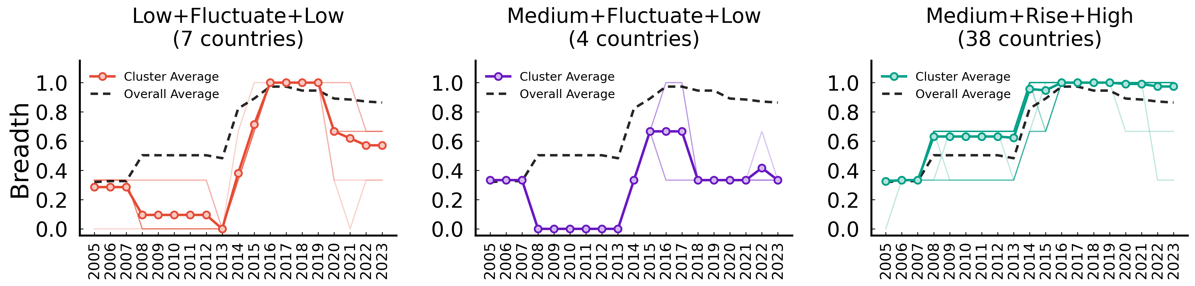
GHG emissions data and reporting (Breadth)
ID | Trajectory Features | Mean Start | Countries
Cluster 2 | Low -> Fluctuate -> Low | 0.286 | 7 (ARG, CHL, COL, CRI, IDN, IND, ZAF)
Cluster 1 | Medium -> Fluctuate -> Low | 0.333 | 4 (CHN, ISR, PER, SAU)
Cluster 0 | Medium -> Rise -> High | 0.330 | 38 (AUS, AUT, BEL, BGR, CAN, CHE, CZE, DEU, DNK, ES...)

Slide 8
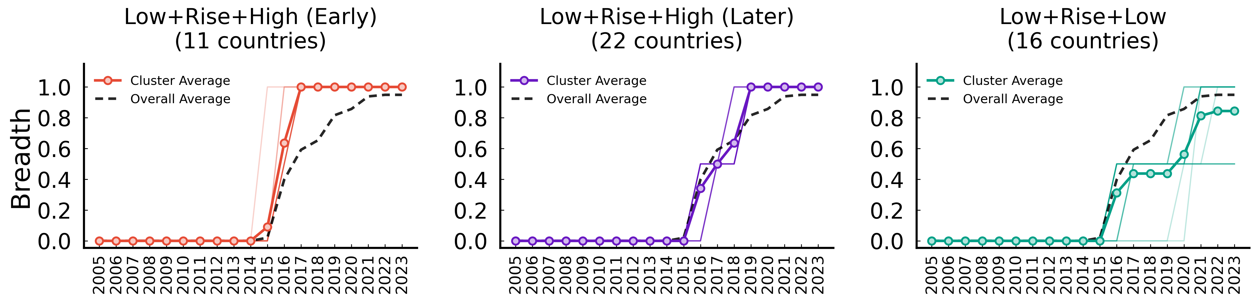
GHG emissions targets (Breadth)
ID | Trajectory Features | Mean Start | Countries
Cluster 1 | Low -> Rise -> High (Early) | 0.000 | 11 (CRI, DEU, FIN, FRA, GBR, ISL, LUX, NOR, NZL, PR...)
Cluster 2 | Low -> Rise -> High (Later) | 0.000 | 22 (ARG, AUT, BGR, CAN, CHE, CHL, COL, DNK, ESP, ES...)
Cluster 0 | Low -> Rise -> Low | 0.000 | 16 (AUS, BEL, CHN, CZE, IDN, IND, ISR, JPN, MEX, NL...)

Slide 9
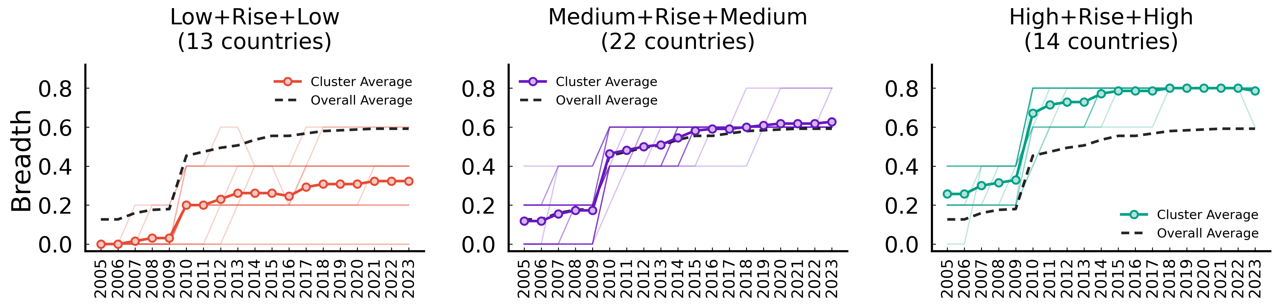
Industry – market-based instruments (Breadth)
ID | Trajectory Features | Mean Start | Countries
Cluster 0 | Low -> Rise -> Low | 0.005 | 13 (ARG, AUS, COL, CRI, HRV, IDN, IND, MLT, PER, RO...)
Cluster 2 | Medium -> Rise -> Medium | 0.130 | 22 (BEL, BGR, CHE, CHL, CHN, CZE, DEU, EST, GBR, GR...)
Cluster 1 | High -> Rise -> High | 0.271 | 14 (AUT, CAN, DNK, ESP, FIN, FRA, HUN, IRL, ITA, NZ...)

Slide 10
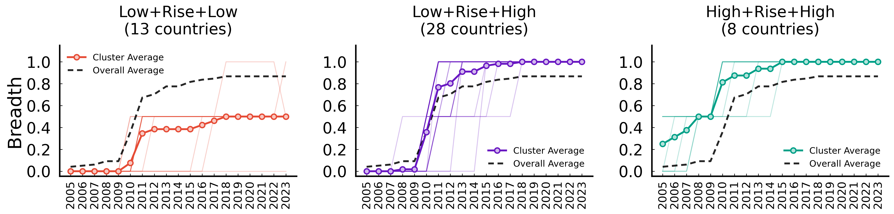
Industry – non market-based instruments (Breadth)
ID | Trajectory Features | Mean Start | Countries
Cluster 0 | Low -> Rise -> Low | 0.000 | 13 (ARG, EST, IDN, ISL, LTU, LUX, LVA, MLT, PER, RU...)
Cluster 2 | Low -> Rise -> High | 0.000 | 28 (AUT, BEL, BGR, CHE, CHL, COL, CZE, DEU, DNK, ES...)
Cluster 1 | High -> Rise -> High | 0.312 | 8 (AUS, CAN, CHN, CRI, ISR, KOR, MEX, NZL)

Slide 11
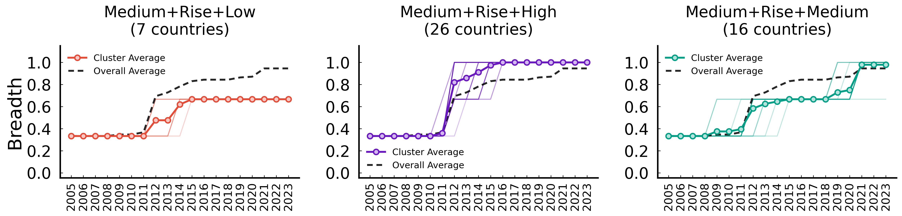
International climate co-operation (Breadth)
ID | Trajectory Features | Mean Start | Countries
Cluster 1 | Medium -> Rise -> Low | 0.333 | 7 (ARG, CHN, COL, IND, PER, RUS, ZAF)
Cluster 0 | Medium -> Rise -> High | 0.333 | 26 (AUT, BEL, BGR, CZE, DEU, DNK, ESP, EST, FIN, FR...)
Cluster 2 | Medium -> Rise -> Medium | 0.333 | 16 (AUS, CAN, CHE, CHL, CRI, GRC, IDN, ISR, JPN, KO...)

Slide 12
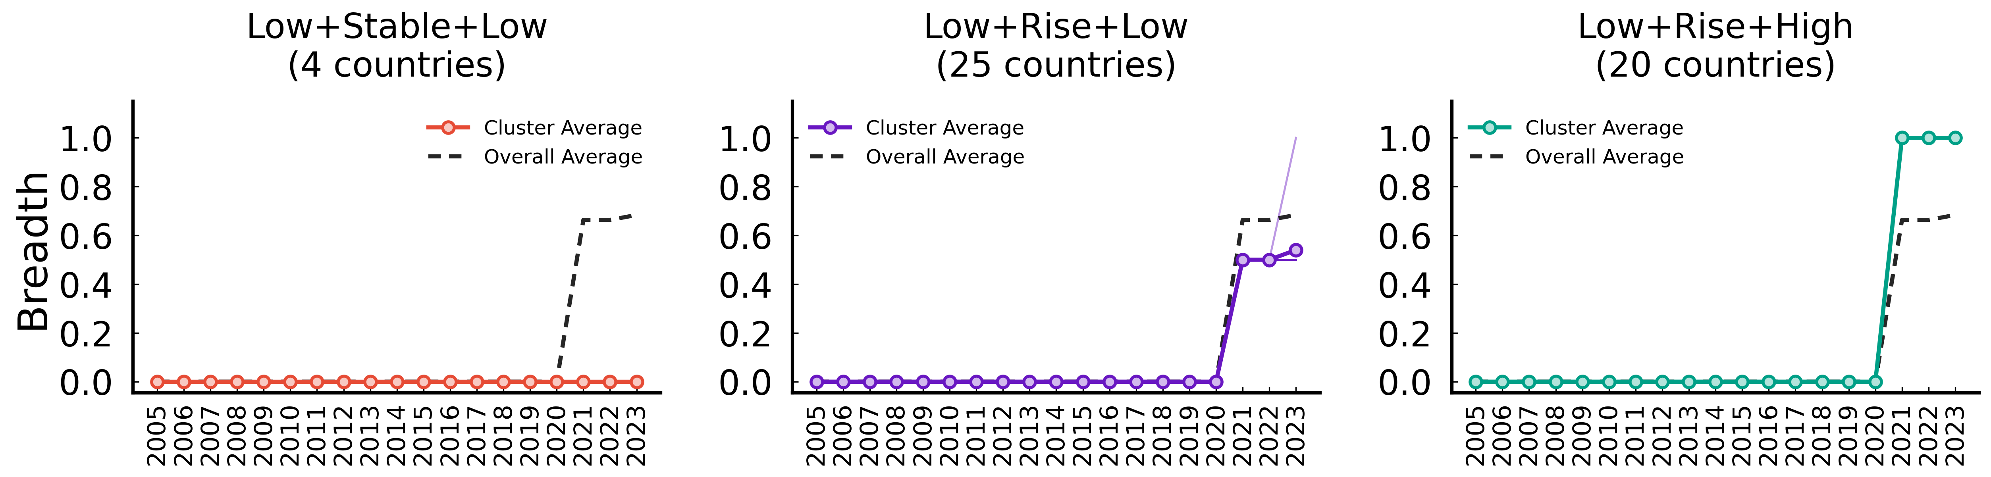
International public finance (Breadth)
ID | Trajectory Features | Mean Start | Countries
Cluster 1 | Low -> Stable -> Low | 0.000 | 4 (CHL, COL, ISR, PER)
Cluster 2 | Low -> Rise -> Low | 0.000 | 25 (ARG, AUT, BGR, CHN, CRI, CZE, EST, GRC, HRV, HU...)
Cluster 0 | Low -> Rise -> High | 0.000 | 20 (AUS, BEL, CAN, CHE, DEU, DNK, ESP, FIN, FRA, GB...)

Slide 13
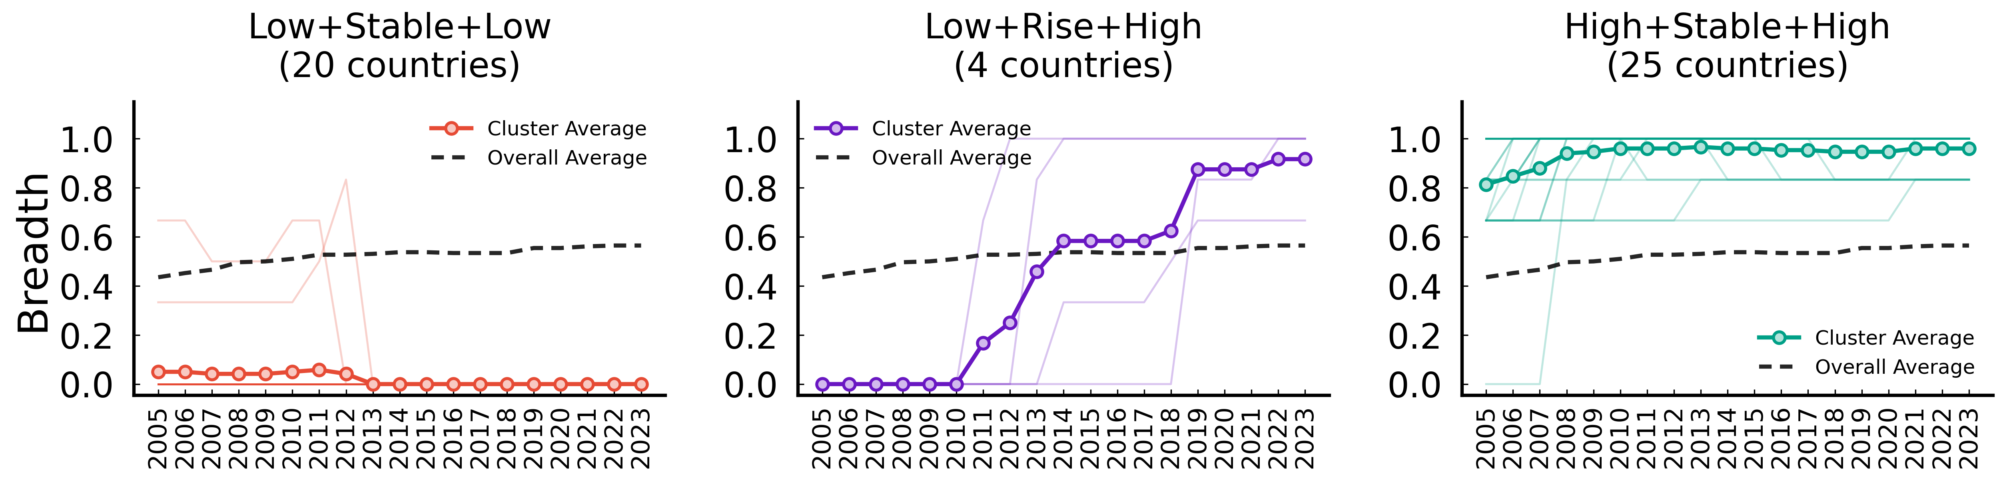
Public Research, Development and Demonstration (Breadth)
ID | Trajectory Features | Mean Start | Countries
Cluster 1 | Low -> Stable -> Low | 0.047 | 20 (ARG, BGR, CHN, COL, CRI, GRC, HRV, IDN, IND, IS...)
Cluster 2 | Low -> Rise -> High | 0.000 | 4 (CHL, EST, LTU, MEX)
Cluster 0 | High -> Stable -> High | 0.847 | 25 (AUS, AUT, BEL, CAN, CHE, CZE, DEU, DNK, ESP, FI...)

Slide 14
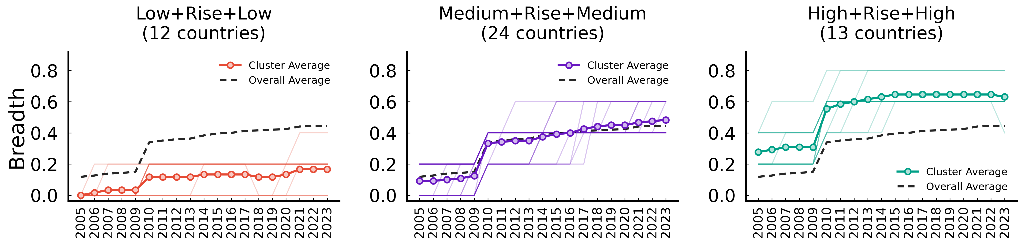
Transport – market-based instruments (Breadth)
ID | Trajectory Features | Mean Start | Countries
Cluster 0 | Low -> Rise -> Low | 0.017 | 12 (BGR, CHL, HRV, IDN, IND, LUX, MLT, PER, ROU, RU...)
Cluster 1 | Medium -> Rise -> Medium | 0.094 | 24 (ARG, AUS, AUT, BEL, CHE, CHN, COL, CRI, CZE, DE...)
Cluster 2 | High -> Rise -> High | 0.292 | 13 (CAN, DNK, FIN, FRA, GBR, IRL, JPN, NOR, NZL, PO...)

Slide 15
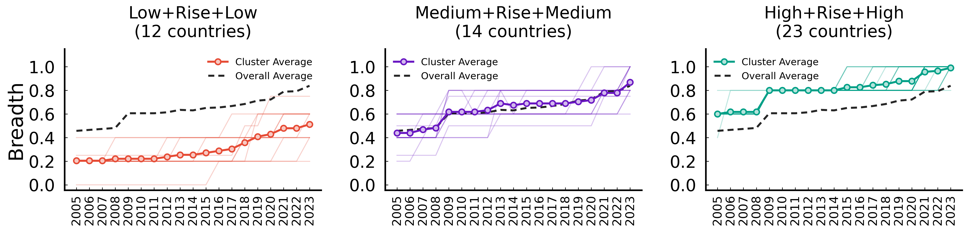
Transport – non market-based instruments (Breadth)
ID | Trajectory Features | Mean Start | Countries
Cluster 0 | Low -> Rise -> Low | 0.204 | 12 (ARG, CHL, COL, CRI, IDN, IND, ISL, ISR, PER, SA...)
Cluster 2 | Medium -> Rise -> Medium | 0.449 | 14 (AUS, BGR, CAN, CHE, DEU, EST, HRV, LVA, MEX, ML...)
Cluster 1 | High -> Rise -> High | 0.612 | 23 (AUT, BEL, CHN, CZE, DNK, ESP, FIN, FRA, GBR, GR...)

